Slide 1
Engineering Geophysics Course
(G312)

Slide 2
.
INTRODUCTION:
engineering geophysics can be defined as one of the application of geophysical survey techniques to site investigations for civil engineering purposes. Common investigations include: finding the depth to bedrock for foundation studies; determining the rippability of material for excavations; measuring the degree of fracturing of rock; the detection of underground fissures, cavities, and mine-shafts; the location of pipes; and, in a marine environment, the determination of the strength of sediment infill and the detection of dangerous near-surface gas pockets before drilling with a jack-up rig.

Slide 3
Refraction Method
Lecture 1

Slide 4
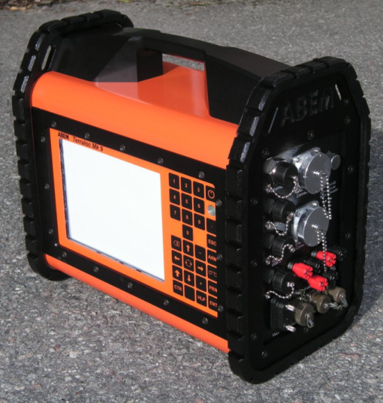
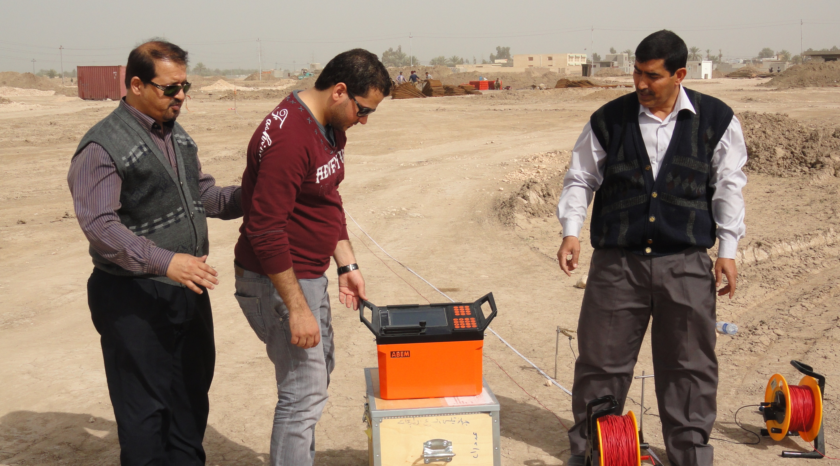
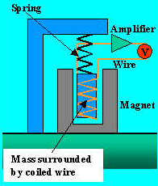
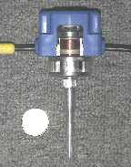
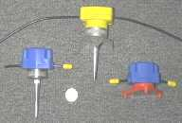
Refraction Instruments
Terraloc Mark-6
Terraloc Mark-9
Geophones

Slide 5
Geophone is essentially only type of sensor used on land. A geophone comprises a coil suspended from springs inside a magnet. When the ground vibrates in response to
a passing seismic wave, the coil moves inside the magnet, producing a voltage, and thus a current, in the coil by induction.

Slide 6
-Applications of Refraction Method:
Used as a reconnaissance tool where no information available about subsurface geology
Geotechnical and Engineering application to determine depth to interface
Detection of fracture zones in connection to ground water prospecting,
Hazardous waste disposal program
Soil foundations
Ground water table
Determine depth of the Bedrock

Slide 7
Refraction Theory
Lecture 2

Slide 8
Refraction Theory
In particular, seismic refraction surveys can provide rapid and a valuable technique to control and solve many problems underneath the ground surface.
It based on the measurement of the travel time of seismic waves refracted at the interfaces between subsurface layers of different velocity.
Seismic energy
(P and S waves) are generated by a source located on the surface (hammer, weight drop or small explosive charge), propagate through the soil and rock, and are recorded by geophones at known distances from the source.

Slide 9

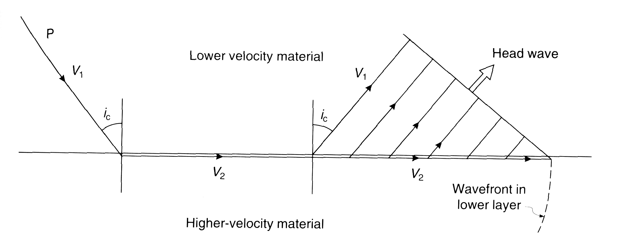
Seismic refraction is mainly depends on the Snell's law. Since the critical angle is equals 90 degree and then the critically refracted waves pass the interface between two media have velocities V1 and V2. When the seismic wave front encounters an interface where seismic velocity drastically increases, a portion of the wave critically refracts at the interface, traveling laterally along higher velocity layers. Due to a compressional stresses existed along the interface boundary, a portion of the wave front returns to the surface as totally reflected waves.

Slide 10
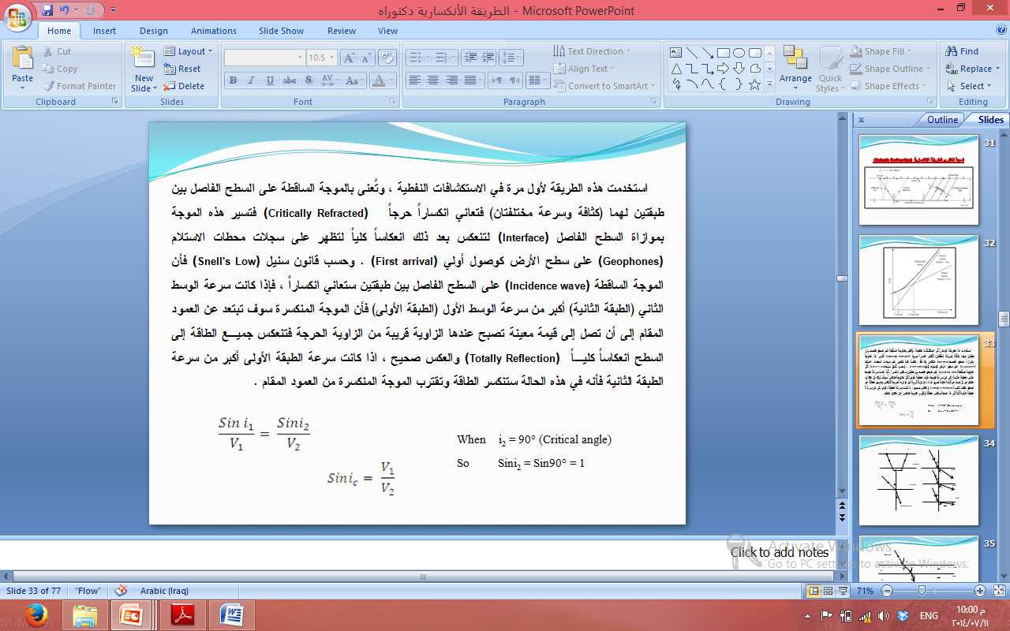
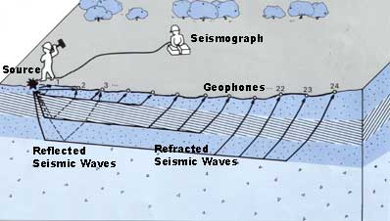
A series of seismic receivers, geophones (right) are laid out along the survey line at regular intervals and receive the reflected wave energy.
Seismic Refraction Data Acquisition:

Slide 11
Advantages:
Provides data to depths of 100 feet or more.
Resolves up to 2 or 3 layers.
Provides a 2D cross-section of P-wave velocity.
The source of seismic energy can be as simple as 8-pound sledgehammer.
Limitations:
The survey line length may be 4 to 5 times the desired depth of investigation;
Sensitive to acoustic noise and vibrations.
Seismic velocity of layers must increase with depth (will not resolve low velocity layers below high velocity layers).
Will not detect thin layers.
Deep measurements may require explosives as an energy source.

